Slide 1




Introduction to Git and GitHub
Speaker:
Suyog Dahal
Susan Ghimire

Slide 2



Table of contents
GitHub Pages
GitHub Actions
VS Code Extensions

Slide 3
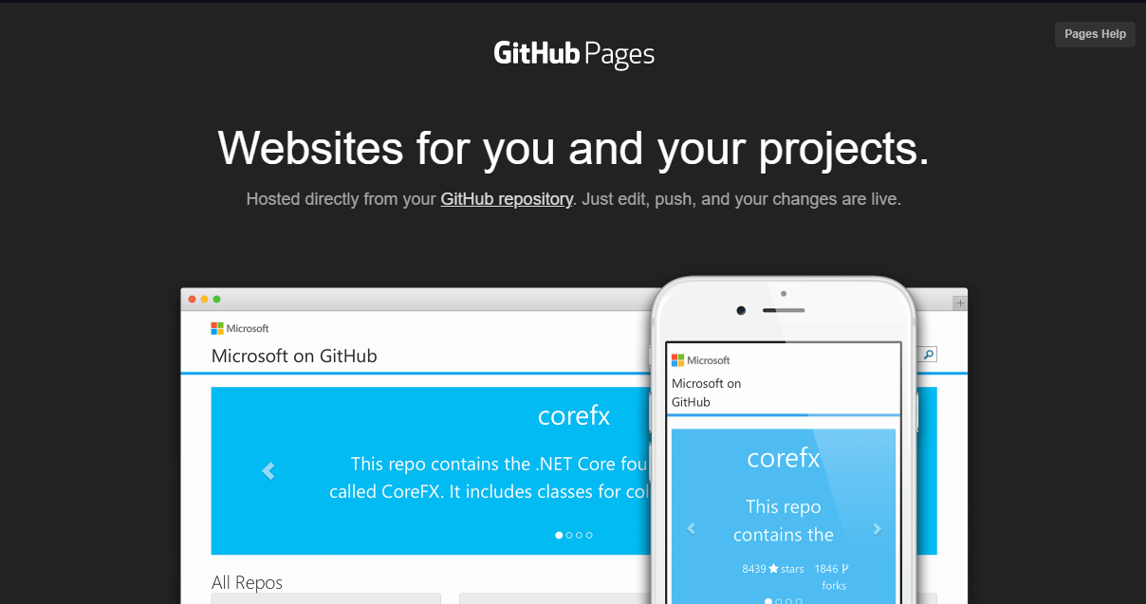
What is GitHub Pages?
A static site hosting service that takes HTML, CSS, and JavaScript files straight from a repository on GitHub, optionally runs the files through a build process, and publishes a website.
You can use GitHub Pages to host a website about yourself, your organization, or your project directly from a repository on GitHub.com.

Slide 4

More about GitHub Pages
It’s FREE
One site per GitHub account and organization (https://username.github.io)
Unlimited project sites. (http://username.github.io/repository)

Slide 5

Usage Limits
GitHub Pages source repositories have a recommended limit of 1GB.
GitHub Pages sites have a soft bandwidth limit of 100GB per month.
GitHub Pages sites have a soft limit of 10 builds per hour.

Slide 6
What is a GitHub Actions?
A continuous integration and continuous delivery (CI/CD) platform to automate your build, test, and deployment pipeline.
You can create workflows that build and test every pull request to your repository, or deploy merged pull requests to production.

Slide 7
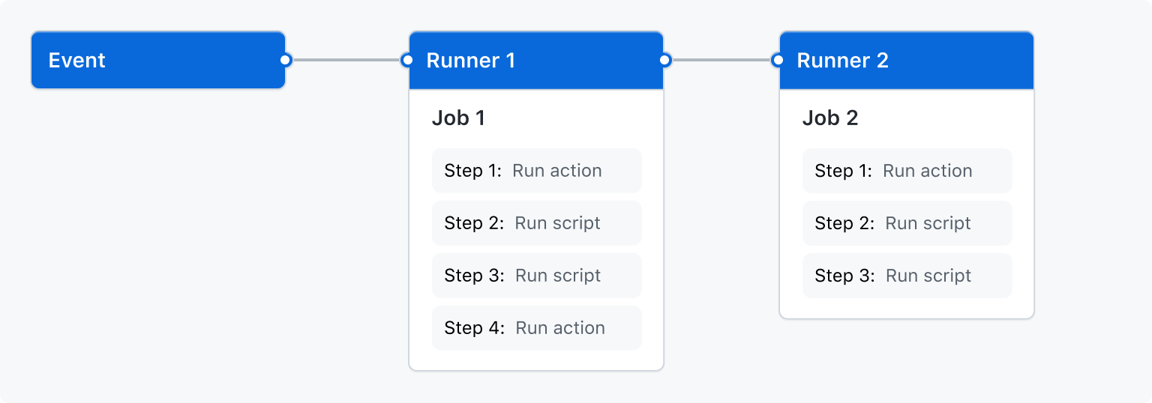
Working of GitHub Actions
You can configure a GitHub Actions workflow to be triggered when an event occurs in your repository.
Your workflow contains one or more jobs which can run in sequential order or in parallel.
Each job will run inside its own virtual machine runner, or inside a container, and has one or more steps

Slide 8
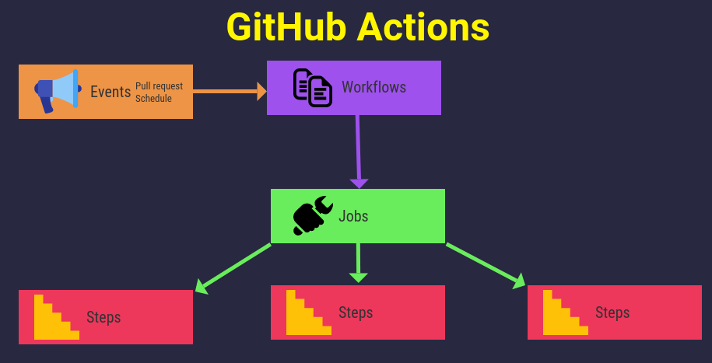
Components of GitHub Actions
Workflows
A workflow is a configurable automated process that will run one or more jobs. You must create a YAML file to define your workflow configuration.
Syntax for YAML: Here
Events
An event is a specific activity in a repository that triggers a workflow run.

Slide 9

Components of GitHub Actions
Jobs
A job is a set of steps in a workflow that execute on the same runner. Each step is either a shell script that will be executed, or an action that will be run.
Runners
A runner is a server that runs your workflows when they're triggered. Each runner can run a single job at a time. GitHub provides Ubuntu Linux, Microsoft Windows, and macOS runners to run your workflows.

Slide 10

Usage Limits for Free Plan
Each job in a workflow can run for up to 6 hours of execution time.
Each workflow run is limited to 72 hours.
You can execute up to 1000 API requests in an hour across all actions within a repository.
You can run upto 20 concurrent jobs in your account

Slide 11
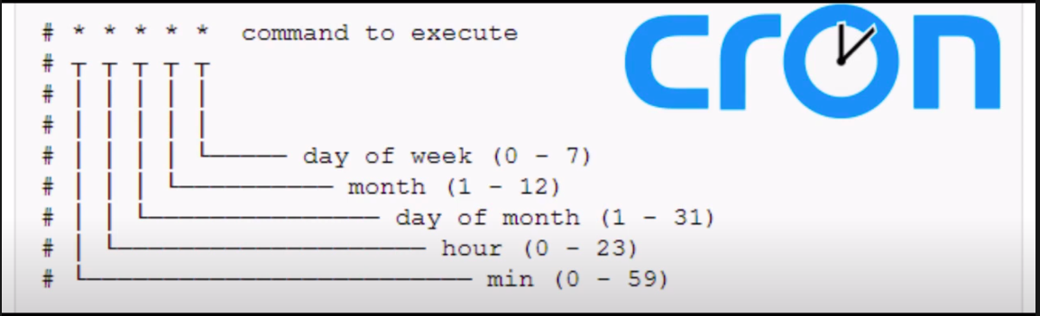
Cron Expression

Slide 12


Slide 13

Assignment
If you’re facing any difficulties:
Contact us at:
Facebook: KEC I.T. Club
KEC Robotics Club

